Slide 1

P.o.i.r.o.t. Politically Optimized Intelligent Real-Fake Organizing Tool
Hari AMOOR
Avi boppana
Xavier boudreau

Slide 2
Spread and impact of fake news
Fake news is 70% more likely to be retweeted than real news^{[1]}
Fake news was rampant during the 2016 election^{[2]}
Fake news causes polarizing and negative discussions^{[3]}
^{[1]}http://science.sciencemag.org/content/359/6380/1146
^{[2]}https://www.buzzfeednews.com/article/craigsilverman/viral-fake-election-news-outperformed-real-news-on-facebook#.gt1ygzDN
[3] https://journals.plos.org/plosone/article?id=10.1371/journal.pone.0138740

Slide 3


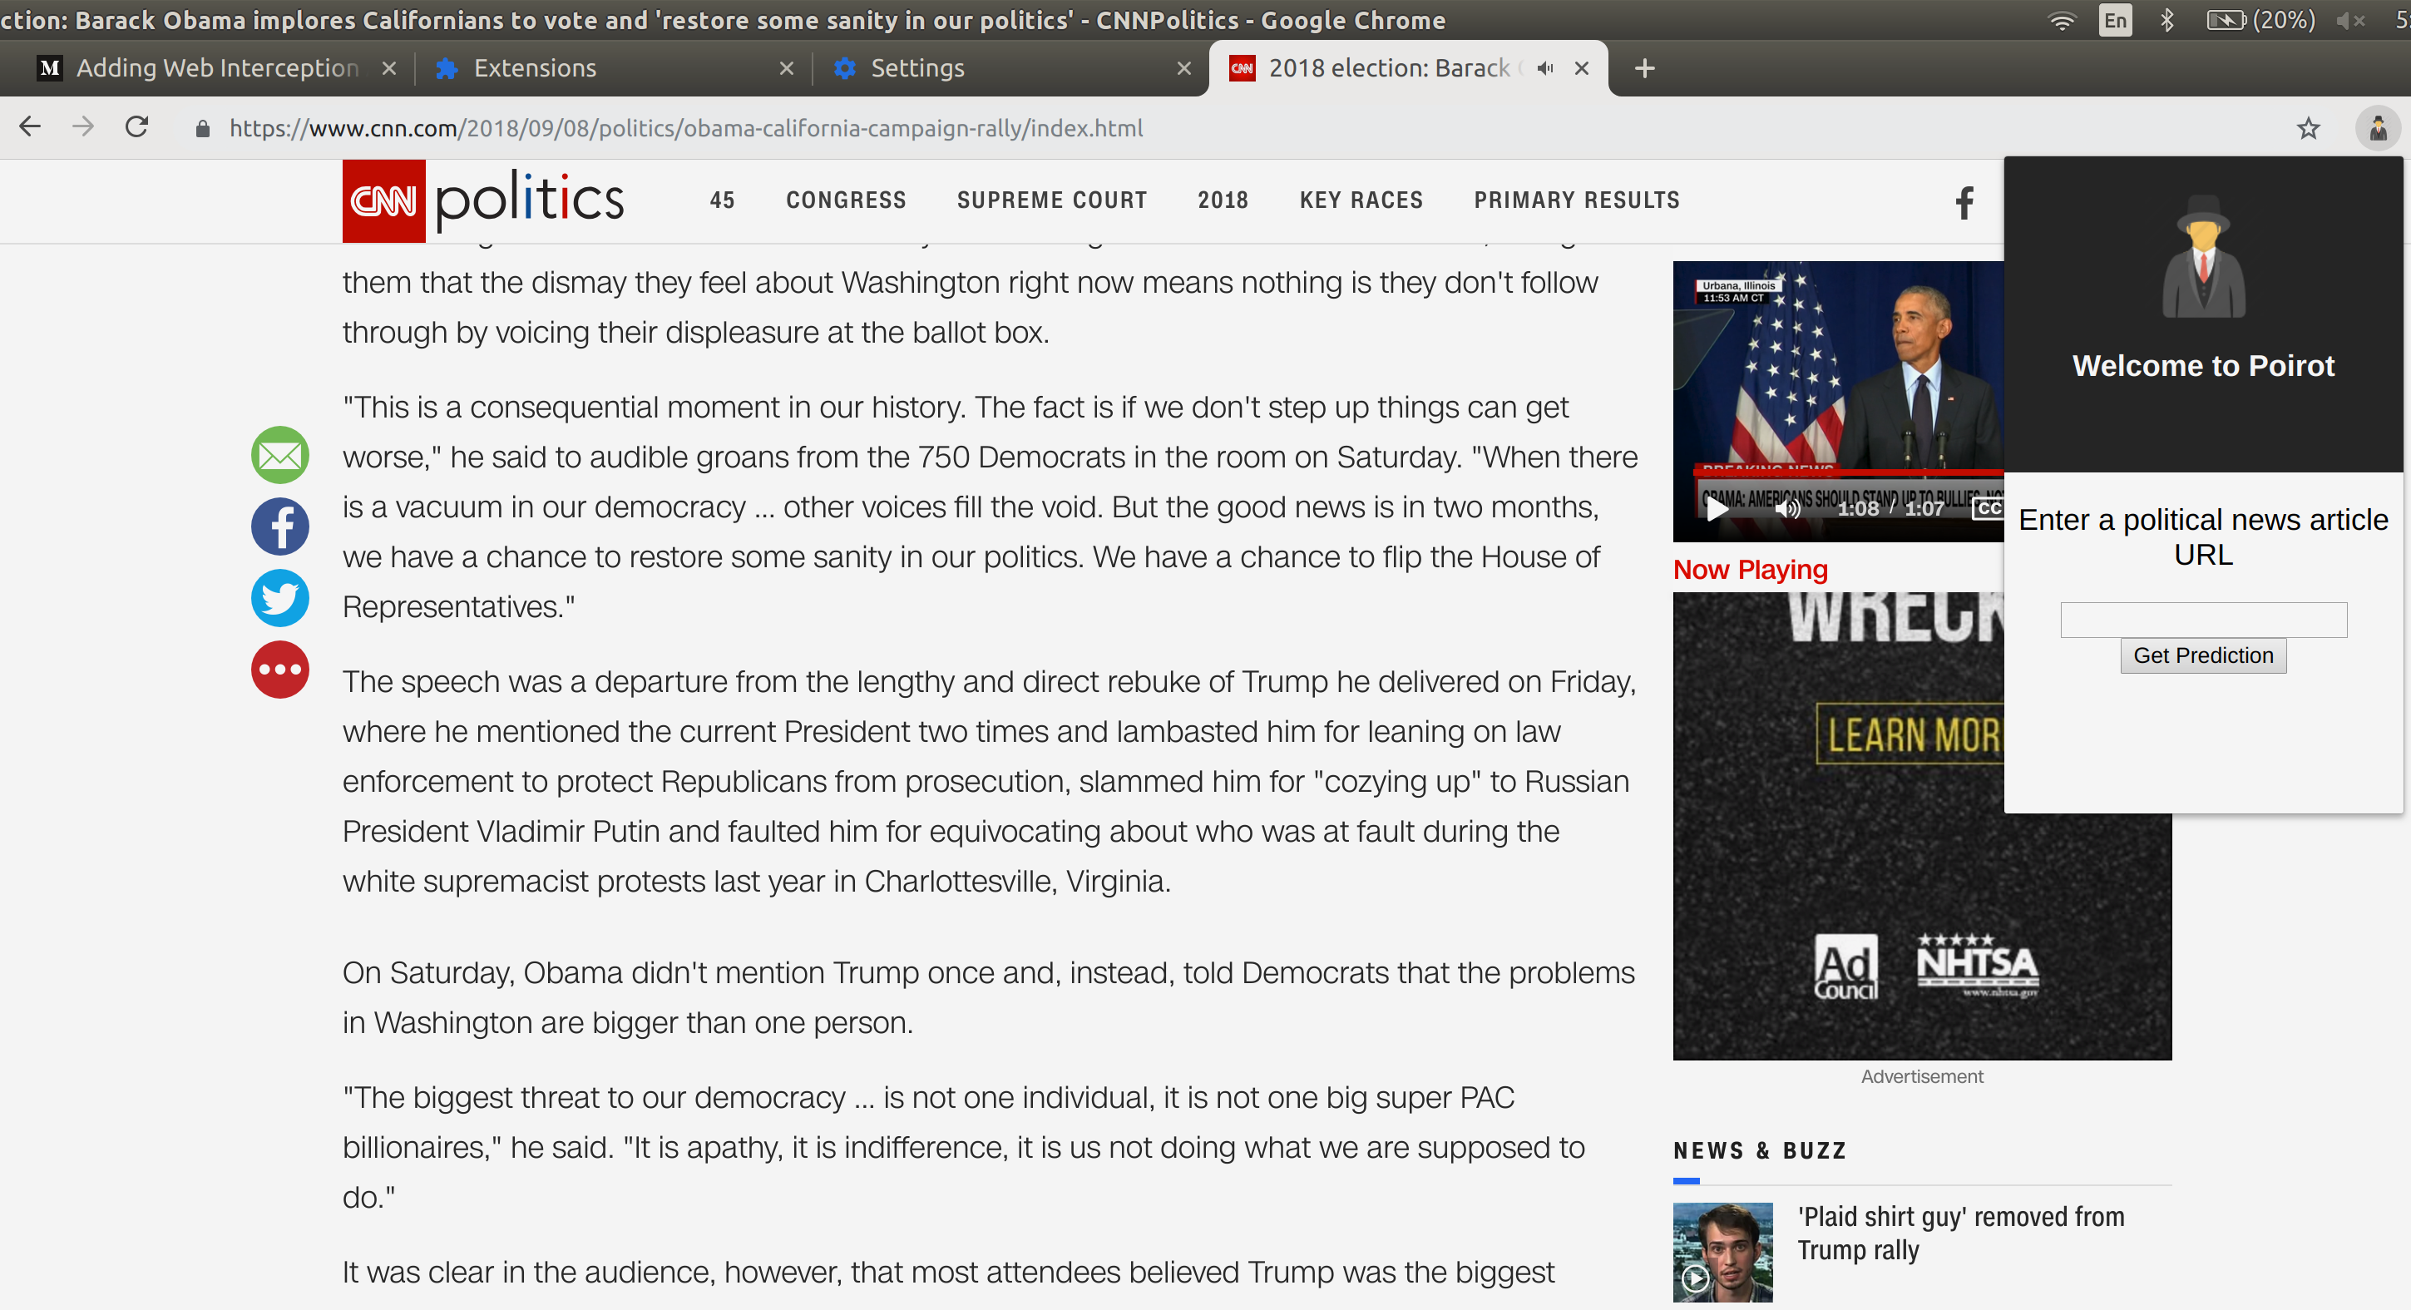
Product
Chrome plug-in
Classifies news article as real or fake with 88% accuracy

Slide 4
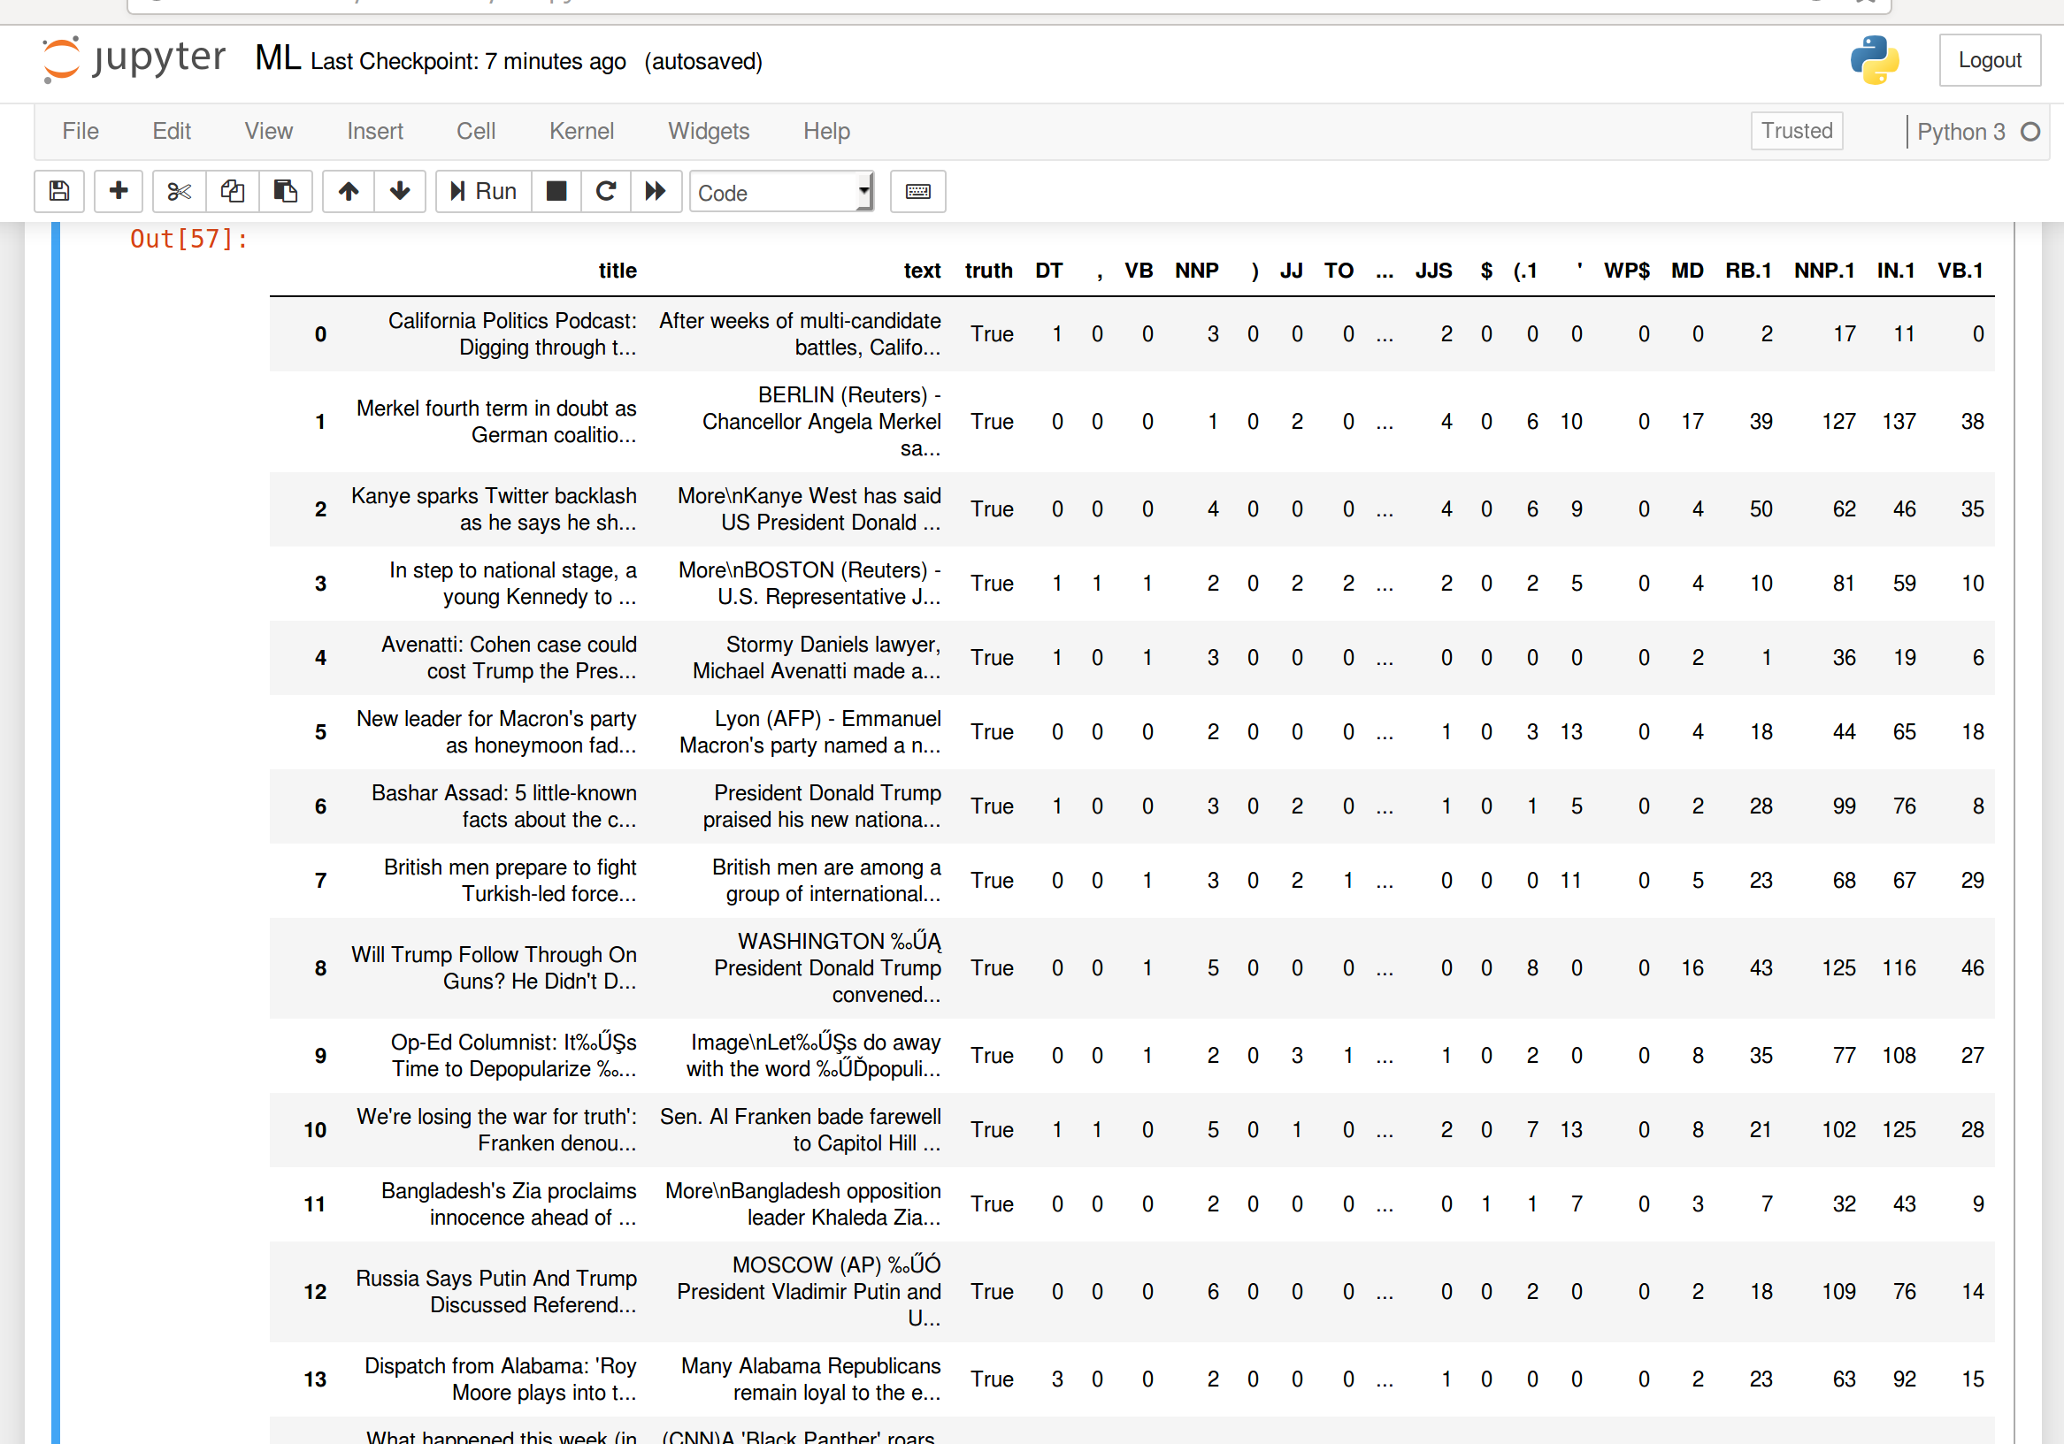
Data collection and storage
NEWS API
Searched for real and fake news using preclassified sources
DiffBot API
Extracted text of article
MongoDB and AWS
Stored news metadata

Slide 5
Model 1 Training (sci-kit Learn)
79% accuracy- proportion of correctly predicted articles outside training set
Identified important features from existing research on Fake News Identification
Included over 30 features such as parts-of-speech, lexical diversity, and punctuation
Natural Language Tool Kit
Pandas
Stacking classifier combines several classifying methodologies into one pipeline

Slide 6
Model 2 Training (sci-kit Learn)
88% accuracy- cross validated with 10 subsets
Preprocessing to remove stop words and capitalization
Random forest classifier enhanced by XGBoost
Input vectors made with term frequency–inverse document frequency

Slide 7
References, Datasets, Tools
“This Just in…”. Benjamin D. Horne and Sibel Adali. 2017.
https://arxiv.org/pdf/1703.09398.pdf
Diffbot Article Extracter API
https://www.diffbot.com/dev/docs/article/
“Getting Real about Fake News”. Megan Risdal.
https://www.kaggle.com/mrisdal/fake-news#fake.csv
News API
https://newsapi.org/
NLTK
https://www.nltk.org/

Slide 8
References, Datasets, Tools (con’t)
Sci-Kit Learn
http://scikit-learn.org/stable/
XGBoost
https://xgboost.readthedocs.io/en/latest/

